Slide 1


DIYALA UNIVERSITY
COLLEGE OF ENGINEERING
DEPARTMENT OF COMMUNICATION ENGINEERING
Electronic Circuits II
Second Year. Lecture 5
lecturer
Wisam Hayder
2021

Slide 2
6. Transformer-Coupled Amplifier
Homework
Ex 1. Determine the necessary transformer turn ratio for
transferring maximum power to a 16 Ω load from a source
that has an output impedance of 10 k Ω. Also calculate the voltage
across the external load if the terminal voltage of the source is
10V r.m.s.
Ex 2. The output resistance of the transistor shown in Fig. 1 is 3kΩ. The primary of the transformer has a d.c. resistance of 300 Ω and the load connected across secondary is 3Ω. Calculate the turn ratio of the transformer for transferring maximum power to the load.
Notes:
aaa

Slide 3
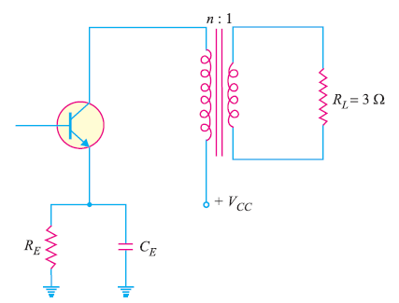
6. Transformer-Coupled Amplifier
Fig.1
Notes:
aaa

Slide 4
7. Direct-Coupled Amplifier
There are many applications in which extremely low frequency (<10 Hz) signals are to be amplified e.g. amplifying photo-electric current, thermo-couple current etc.
The coupling devices such as capacitors and transformers cannot be used because the electrical sizes of these components become very large at extremely low frequencies.
Notes:
aaa

Slide 5
7. Direct-Coupled Amplifier
Under such situations, one stage is directly connected to the next stage without any intervening coupling device.
This type of coupling is known as direct coupling.
Circuit details. Fig. 11.19 shows the circuit of a three-stage direct-coupled amplifier. It uses complementary transistors.
Notes:
aaa

Slide 6
7. Direct-Coupled Amplifier
Thus, the first stage uses npn transistor, the second stage uses pnp transistor and so on.
This arrangement makes the design very simple.
The output from the collector of first transistor T1 is fed to the input of the second transistor T2 and so on.

Slide 7
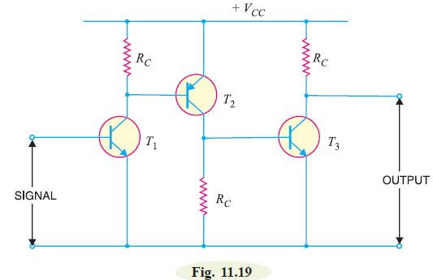
7. Direct-Coupled Amplifier
Notes:
aaa

Slide 8
7. Direct-Coupled Amplifier
The weak signal is applied to the input of first transistor T1.
Due to transistor action, an amplified output is obtained across the collector load RC of transistor T1.
This voltage drives the base of the second transistor and amplified output is obtained across its collector load.
In this way, direct coupled amplifier raises the strength of weak signal.
Notes:
aaa

Slide 9
7. Direct-Coupled Amplifier
Advantages
(i) The circuit arrangement is simple because of minimum use of resistors.
(ii) The circuit has low cost because of the absence of expensive coupling devices.
Disadvantages
(i) It cannot be used for amplifying high frequencies.
(ii) The operating point is shifted due to temperature variations.
Notes:
aaa

Slide 10
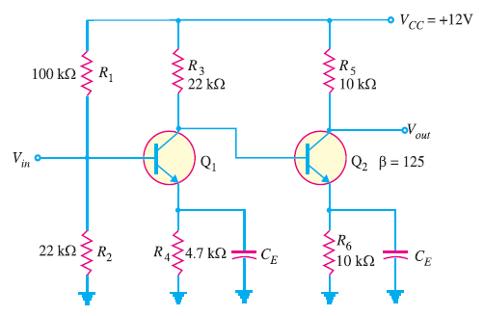
7. Direct-Coupled Amplifier
Fig. 2 shows a direct coupled two-stage amplifier. Determine (i) d.c. voltages for both stages (ii) voltage gain of each stage and overall voltage gain.
Fig. 2
Notes:
aaa

Slide 11
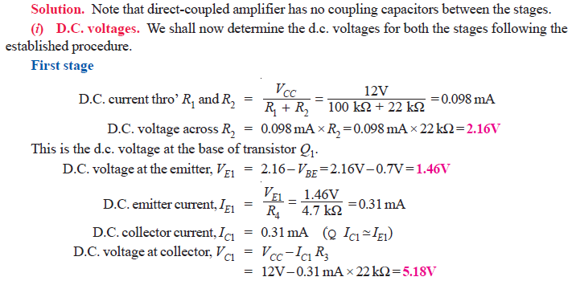
7. Direct-Coupled Amplifier
Notes:
aaa

Slide 12

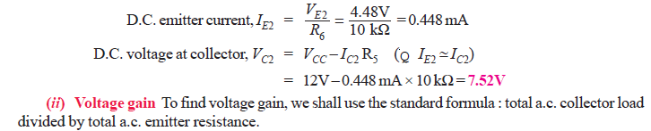
7. Direct-Coupled Amplifier
Notes:
aaa

Slide 13
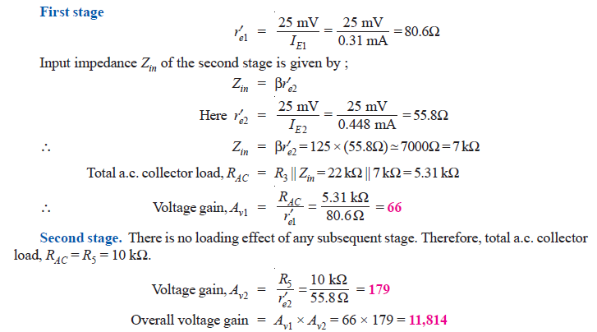
7. Direct-Coupled Amplifier
Notes:
aaa

Slide 14
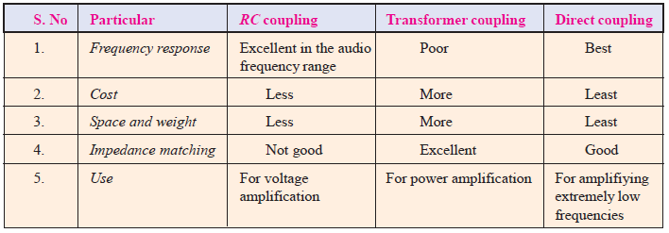
7. Direct-Coupled Amplifier
Comparison of Different Types of Coupling
Notes:
aaa

Slide 15
Transistor Tuned Amplifiers
Tuned Amplifiers
Amplifiers which amplify a specific frequency or narrow band of frequencies are called tuned amplifiers.
Tuned amplifiers are mostly used for the amplification of high or radio frequencies.
It is because radio frequencies are generally single and the tuned circuit permits their selection and efficient amplification.
Notes:
aaa

Slide 16
Transistor Tuned Amplifiers
However, such amplifiers are not suitable for the amplification of audio frequencies as they are mixture of frequencies from 20 Hz to 20 kHz and not single.
Tuned amplifiers are widely used in radio and television circuits where they are called upon to handle radio frequencies.
Notes:
aaa

Slide 17
Transistor Tuned Amplifiers
Fig. 15.1 shows the circuit of a simple transistor tuned amplifier.
Here, instead of load resistor, we have a parallel tuned circuit in the collector.
The impedance of this tuned circuit strongly depends upon frequency.
It offers a very high impedance at resonant frequency and very small impedance at all other frequencies.
Notes:
aaa

Slide 18
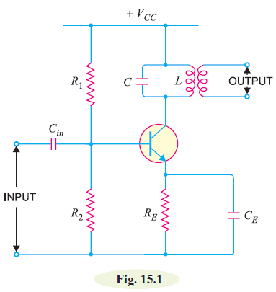
Transistor Tuned Amplifiers

Slide 19
Transistor Tuned Amplifiers
If the signal has the same frequency as the resonant frequency of LC circuit, large amplification will result due to high impedance of LC circuit at this frequency.
When signals of many frequencies are present at the input of tuned amplifier, it will select and strongly amplify the signals of resonant frequency while rejecting all others.

Slide 20
Transistor Tuned Amplifiers
Therefore, such amplifiers are very useful in radio receivers to select the signal from one particular broadcasting station when signals of many other frequencies are present at the receiving aerial.
20

